Slide 1
Iron Kaggle
G1
Mehak
Jurgen
Sven

Slide 2
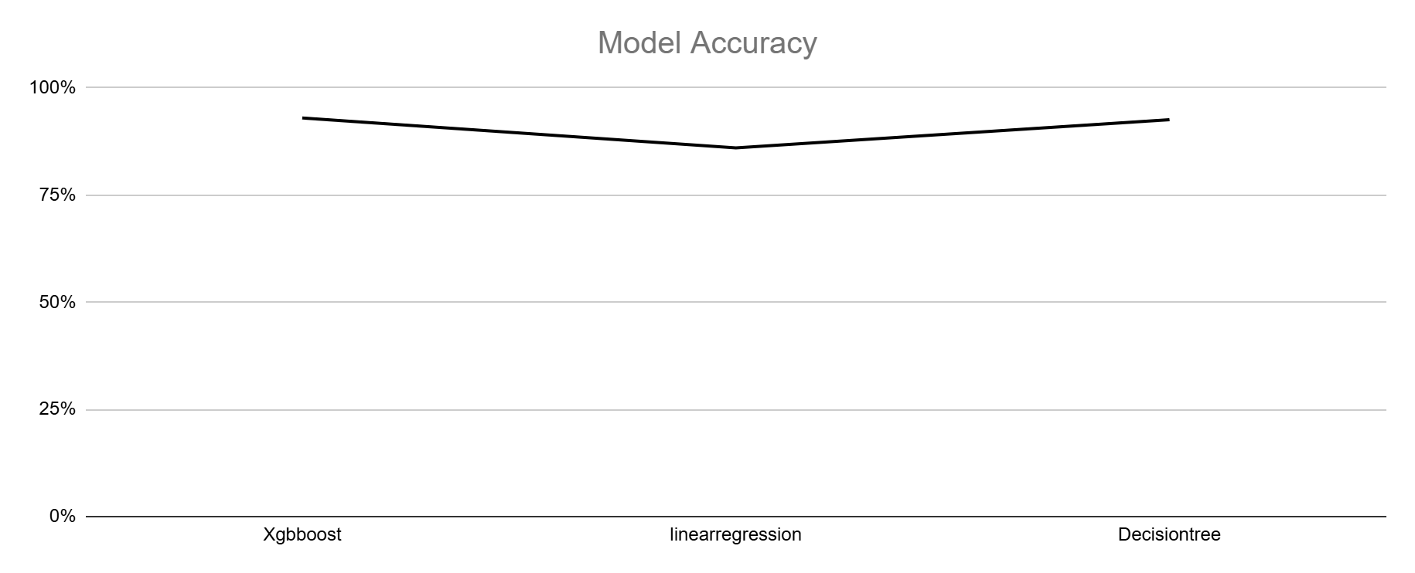
Executive summary
Accuracy with training data (sales.csv): 93%
Best model: xgboost regressor
R² Prediction: 93%
Quick recap of alternatives considered:
LinearRegression 86%
DecisionTreeRegressor 92.6%

Slide 3
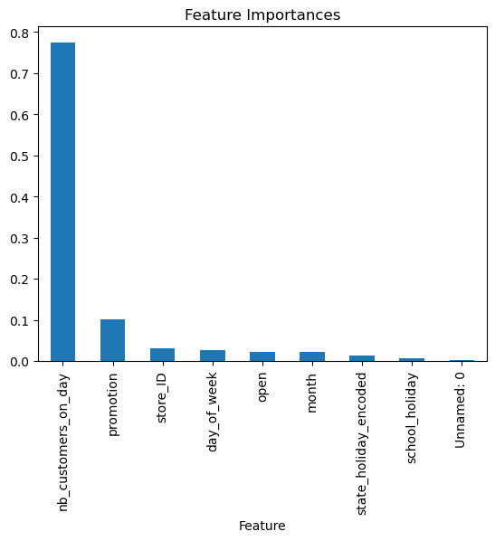
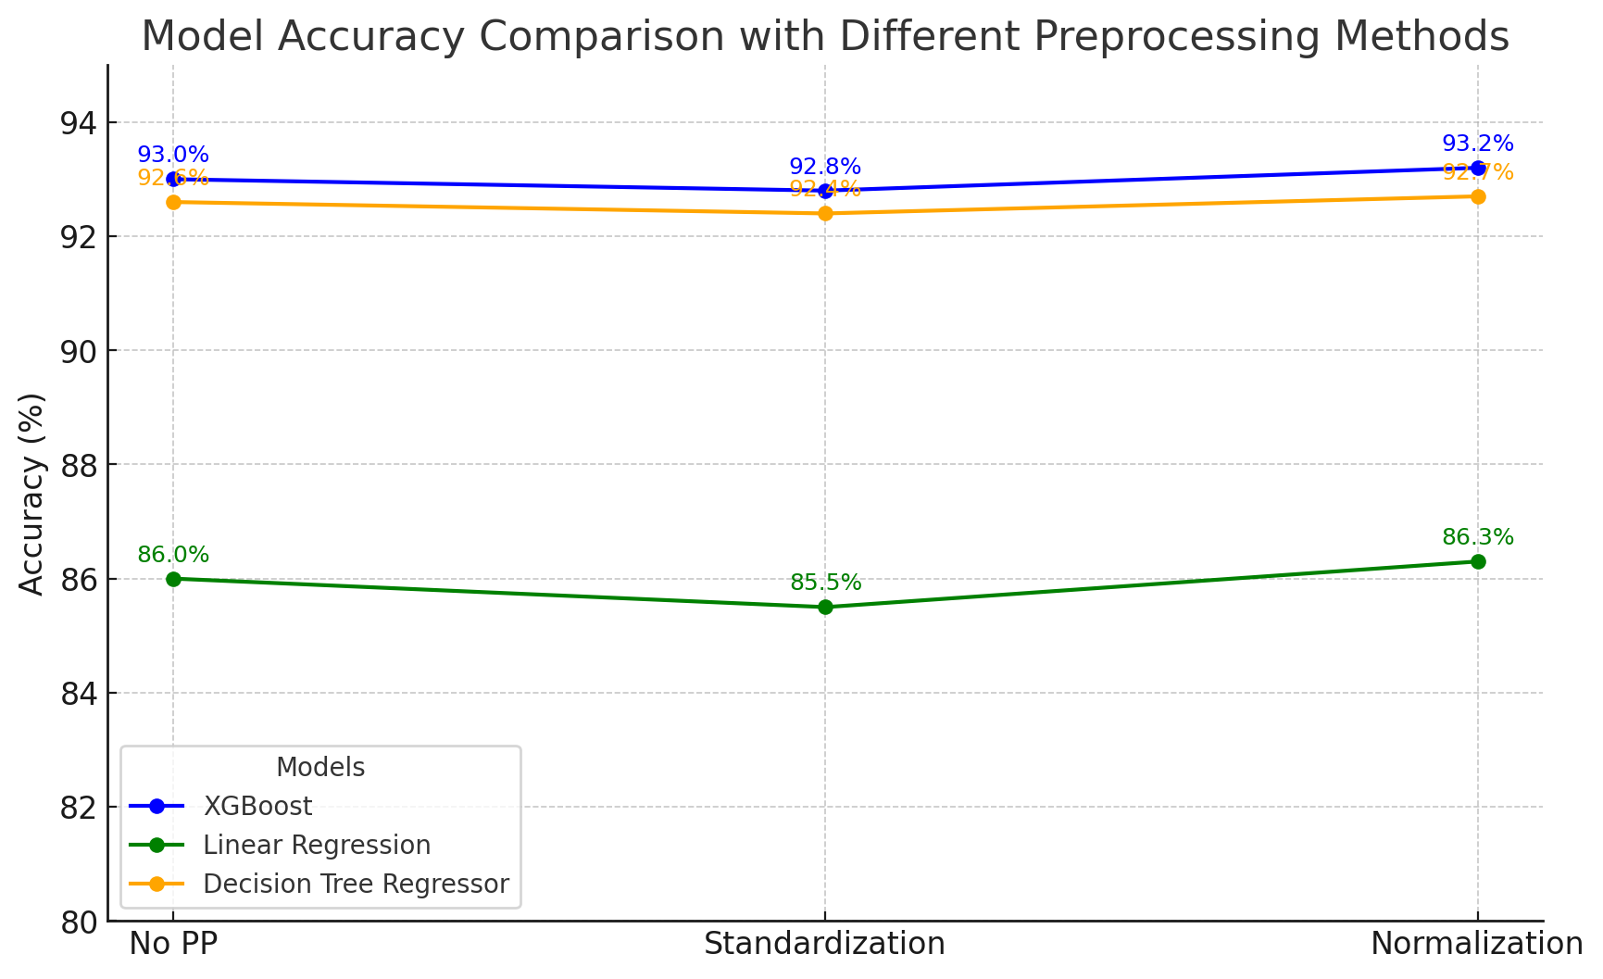
Methods (preprocessing)
Mapped and converted values for the columns ‘date’ and ‘state_holiday’
‘Date’ -> convert to datetime object and extract the month
‘State_holiday’ -> used label encoding
Plotted feature importance
Removed the unnamed column of ID values
Tried out log transformation but without any benefit
Split the data into train and test groups

Slide 4
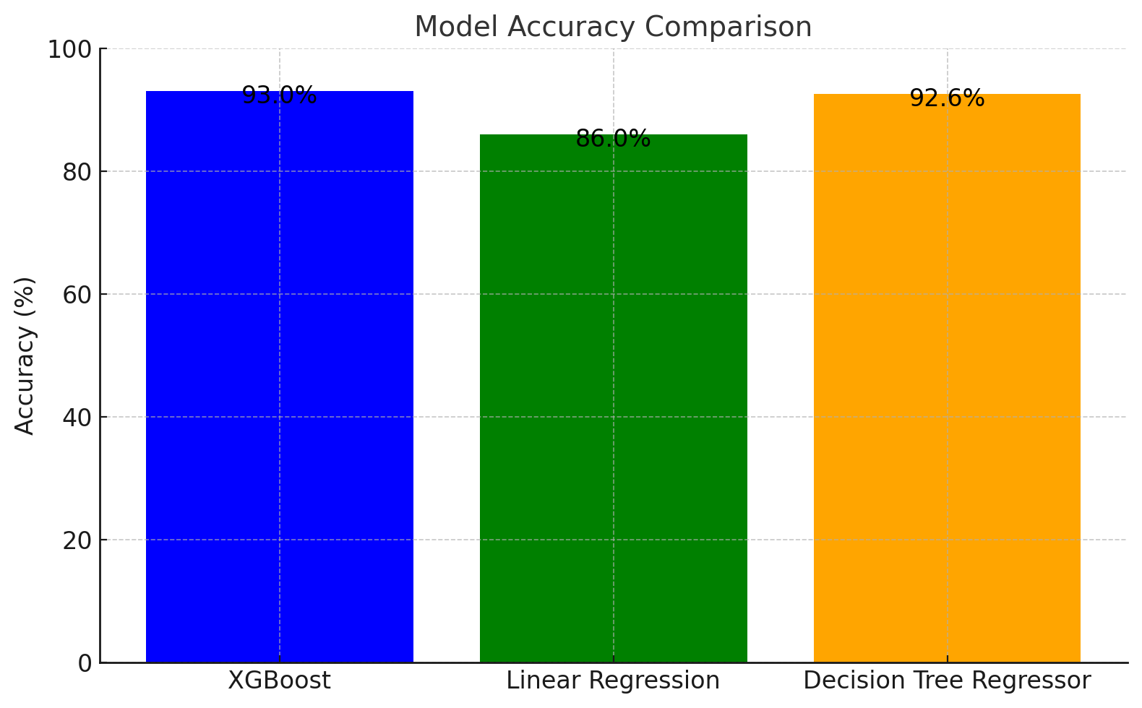
Methods (models) – 1 or 2 slides
Since we need to predict numerical sales values we have selected:
XGBoost Regressor
Prevents overfitting and handles large datasets
Commonly used in forecasting sales
Linear Regression
Decision Tree Regressor

Slide 5
Selected model: XGBoost Regressor
Initial r2 score: 93%
After standardizing feature data: 93%
After normalizing feature data: 93%
Neither normalization nor standardization improved the accuracy of our model

Slide 6
Takeaways
Recap / conclusions
Challenges
How to handle the high correlation between nb_customers_on_day and sales?
Balancing model complexity with model performance
Key learnings
Calculate the accuracy after making bigger changes to the data (e.g. dropping columns) to be able to check if the changes improve the accuracy

Slide 7
Instructions
You can make the charts with python or excel.
All team members must participate (either split the slides, or discuss the part that you did for each slide)
7 minutes maximum for presentation + 3 minutes for questions
7 is a HARD limit. Aim for 5, it should be enough.
Tip: Rehearse the presentation at least once

